Slide 1
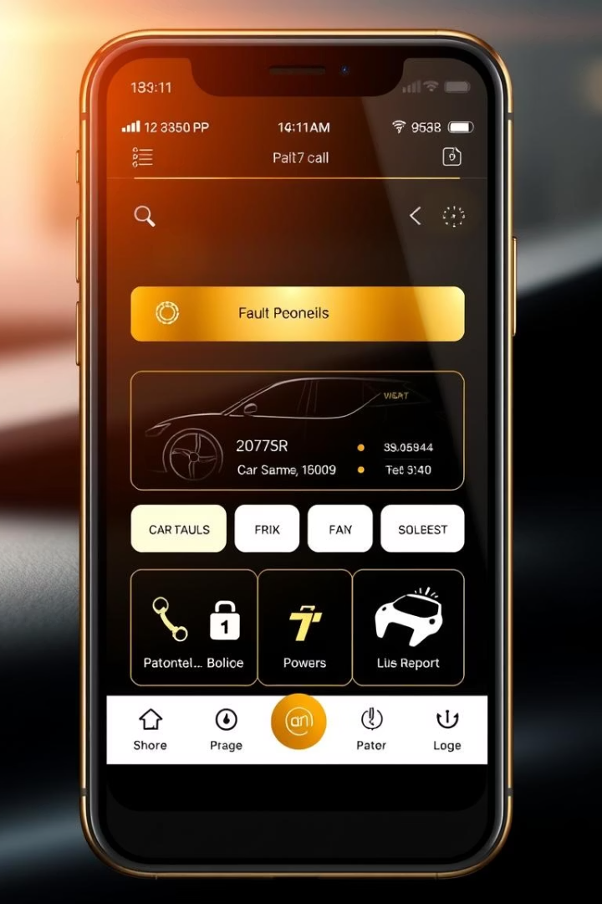
Car Fault Diagnosis Mobile Application
UI design and implementation of our Car Fault Diagnosis Mobile Application. We focused on translating functional requirements into a practical, interactive, and user-friendly mobile experience for car owners and mechanics.
Our objective was to create an app that allows seamless interaction with features like scanning dashboard symbols, recording engine sounds, receiving AI-driven diagnoses, and contacting professionals. This phase prioritizes usability, accessibility, clarity, and responsiveness, ensuring a technically sound, enjoyable product.

Slide 2




App Identity: Car First Aid
The app's official name, "Car First Aid," communicates its core value: providing immediate, accessible, and intelligent diagnostic support. It suggests quick, reliable help for car problems, reducing panic and empowering users with actionable knowledge.
The primary target audience is non-technical car owners, with a secondary audience of mechanics. The brand attributes emphasize trustworthiness through AI diagnosis and certified mechanics, helpfulness via clear suggestions and tutorials, simplicity through intuitive design, and modernity by leveraging advanced AI and smartphone sensors.
Trustworthy
Helpful
Simple
Modern

Slide 3
Visual Design and Layout Strategy
Visual design is central to the user experience, governing readability, navigation, and aesthetic value. We designed the visual experience to reflect clarity, friendliness, and speed, using simple layouts, large touch-friendly buttons, and consistent iconography for a practical and appealing interface.
The app employs a card-based layout, grouping major features with intuitive icons and minimal text. Key screens include the Home Screen for quick actions and the Diagnostic Result Screen for displaying faults and solutions.
Card-Based Layout
Home Screen
Diagnostic Result Screen
Major features are grouped into intuitive blocks with icons and minimal text.
Provides quick access to main actions like scanning the dashboard and giving feedback.
Displays recognized faults, confidence scores, possible causes, and tutorial videos.

Slide 4
Color Palette and Typography
The application uses a friendly and trustworthy visual identity. The light mode features a soft light blue background, deep navy blue for primary text, and a gradient yellow-to-orange accent for primary buttons. Secondary text and links use muted purple.
Dark mode employs black or deep charcoal backgrounds with gold for key elements and white/grey text for legibility. Both modes maintain visual consistency with the same font, iconography, and layout structure. Poppins, a geometric sans-serif, is the primary font, with bold for headings and regular for body text to create visual hierarchy.
Light Mode
Dark Mode
Typography
Primary Background: Soft Light Blue (#F0F6FF)
Backgrounds: Black or Deep Charcoal
Primary Font: Poppins (Geometric Sans-serif)
Primary Text: Deep Navy Blue (#2D2A72)
Key Elements: Gold (#FFD700)
Font Style: Bold for headings, medium for labels, regular for body text
Text: White and Grey
Accent/Buttons: Gradient Yellow to Orange (#FEC901 to #FCA311)

Slide 5
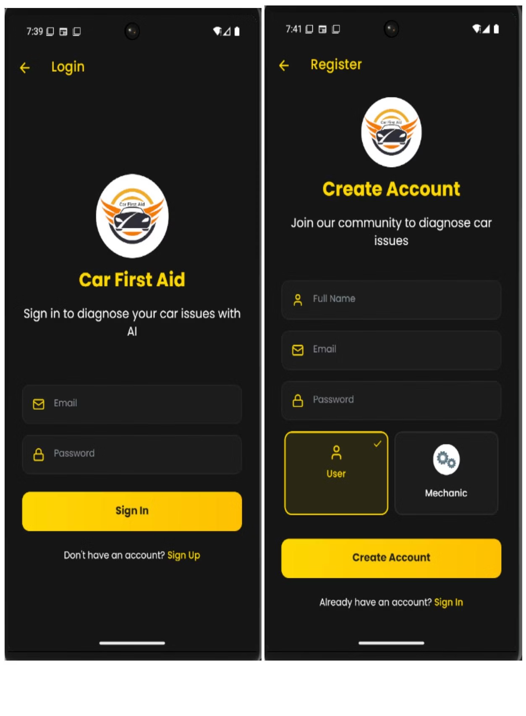



User Authentication and Role Selection
The login screen is the primary entry point, designed for clarity and ease of access. Registered users enter credentials to access their dashboard, while new users tap "Sign Up" to create an account.
Upon tapping "Sign Up," the app prompts users to select a role: "Register as Car Owner" or "Register as Mechanic." This step is crucial as it determines the specific dashboard, functionality, and interface the user will access after registration, ensuring a tailored experience.
Login Screen
Primary entry point for registered users.
Sign Up
New users create an account.
Select User Role
Choose between Car Owner or Mechanic to tailor the app experience.

Slide 6
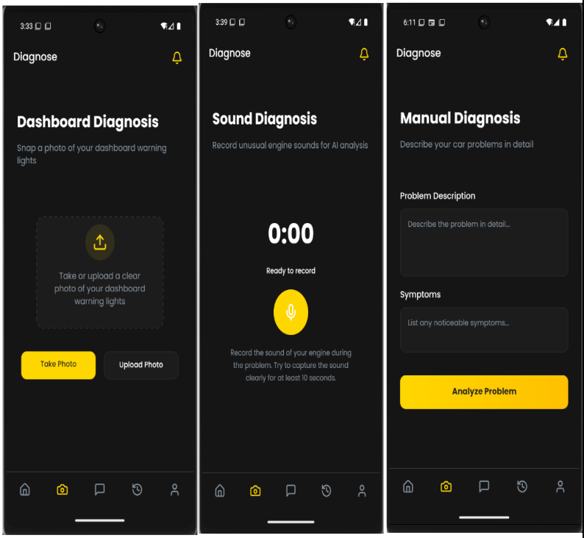
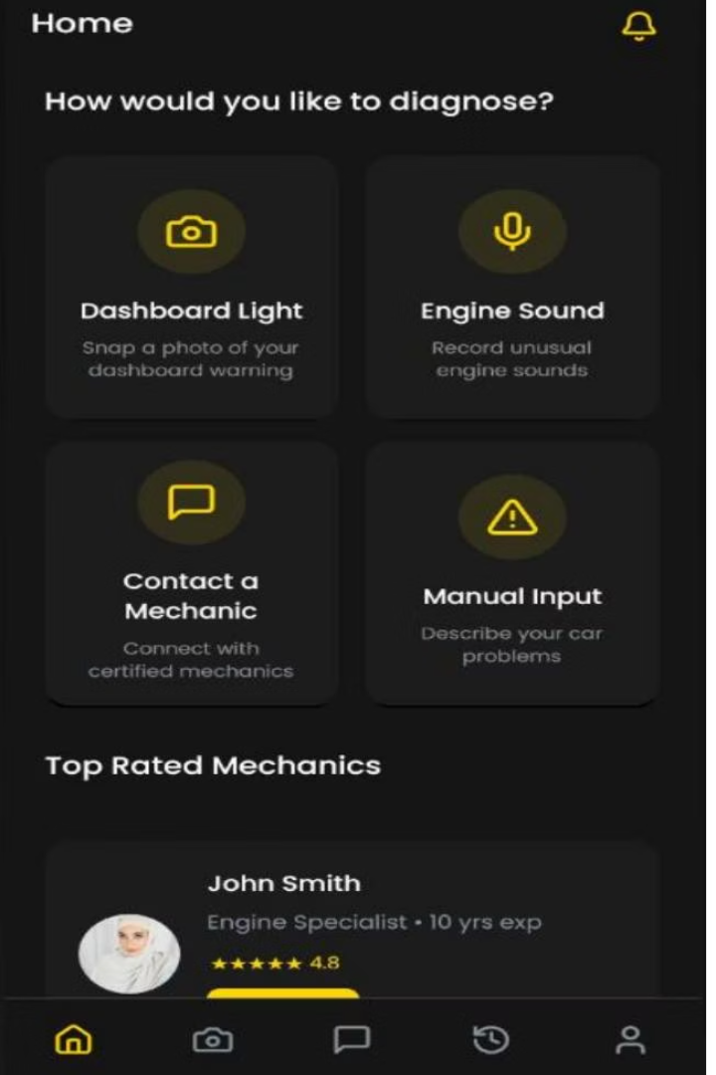
Home Screen and Diagnostic Methods
The user dashboard serves as the central hub for car owners. It features a welcome message and a primary call-to-action: "Car Issues? Get instant AI-powered diagnosis for your vehicle problems." The "Diagnose Now" button directs users to the core fault diagnosis feature.
The dashboard provides four intuitive pathways for diagnosing car issues: Dashboard Light (snap or upload photo), Engine Sound (record unusual sounds), Contact a Mechanic (connect with certified professionals), and Manual Input (describe problems in text).
Dashboard Light
Engine Sound
Snap or upload a photo of your dashboard warning for visual analysis.
Record unusual engine sounds for AI-driven anomaly detection.
Contact a Mechanic
Manual Input
Connect with certified mechanics through a marketplace.
Describe your car problems in text format.

Slide 7
Diagnostic Process and Navigation
When "Dashboard Light" is selected, users can take or upload a photo, leading to AI-generated results and immediate fix suggestions, including YouTube tutorials. For "Engine Sound," the app prompts users to record unusual sounds, which are then processed by an AI engine.
Selecting "Contact a mechanic" opens a page with certified mechanics' contact information and locations. "Manual Input" allows users to describe problems in text. A bottom navigation bar provides quick access to Home, Diagnose, History, Profile, and Mechanic sections.
1
Dashboard Light
Snap or upload photo for AI diagnosis.
2
Engine Sound
Record audio for AI analysis.
3
Contact Mechanic
Browse and message certified mechanics.
4
Manual Input
Describe car problems in text.

Slide 8
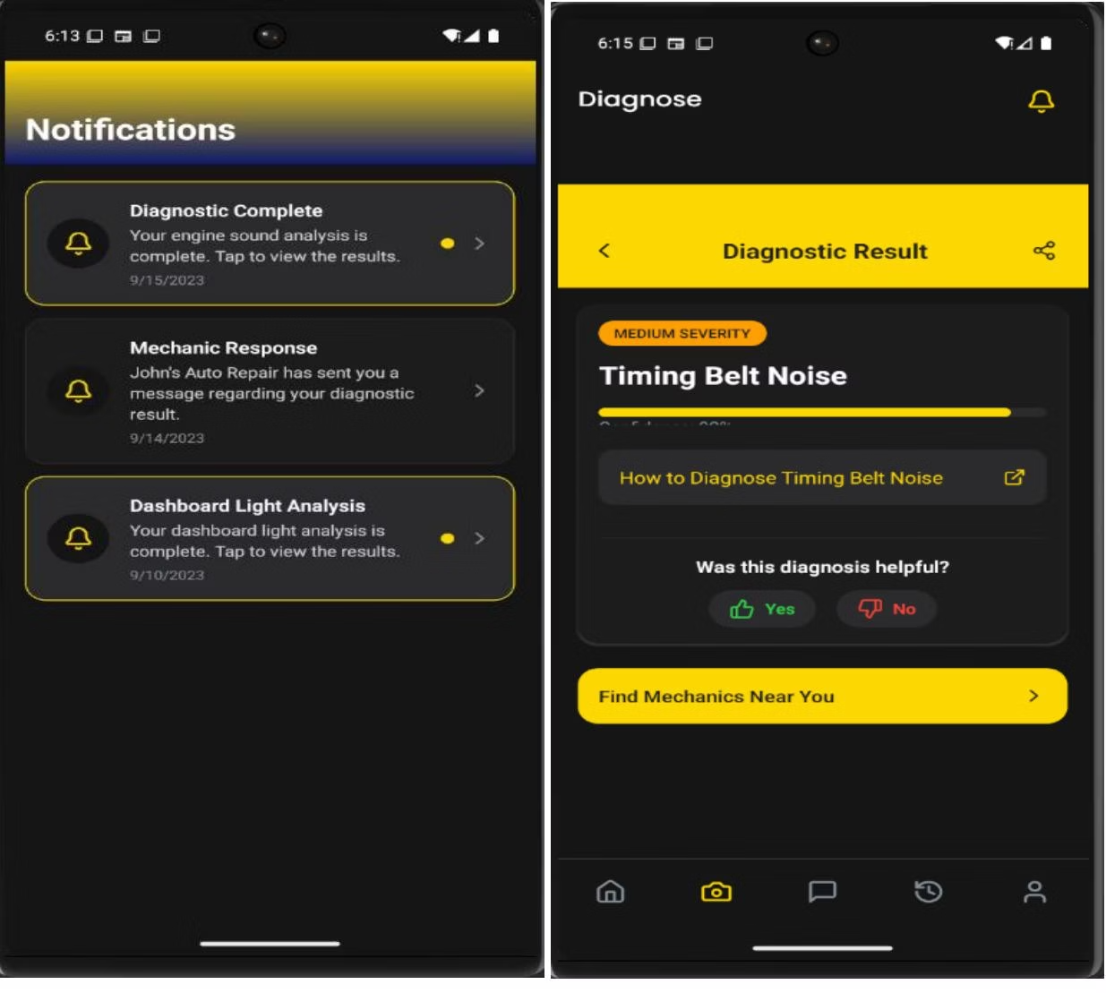




Notifications and User Profile
Tapping the notification bell displays a list of alerts, keeping users updated on past diagnostics and mechanic replies, with the most recent notifications shown first. Tapping a "Diagnostic Complete" notification leads to a detailed results screen, showing identified issues and next steps. Users can also view their diagnosis history, categorized as All, Unresolved, and Resolved.
The Profile screen allows users to manage account settings and preferences. Under "Account," users can edit their profile, customize notification preferences, and manage privacy and security. The "Preferences" section includes a Dark Mode toggle. Both car owner and mechanic profiles are supported, with mechanics having additional functionalities.
Notifications
User Profile
Alerts for diagnostics and mechanic replies.
Manage account settings and preferences.
Preferences
Diagnosis History
Customize app settings, including Dark Mode.
View past diagnoses (All, Unresolved, Resolved).

Slide 9
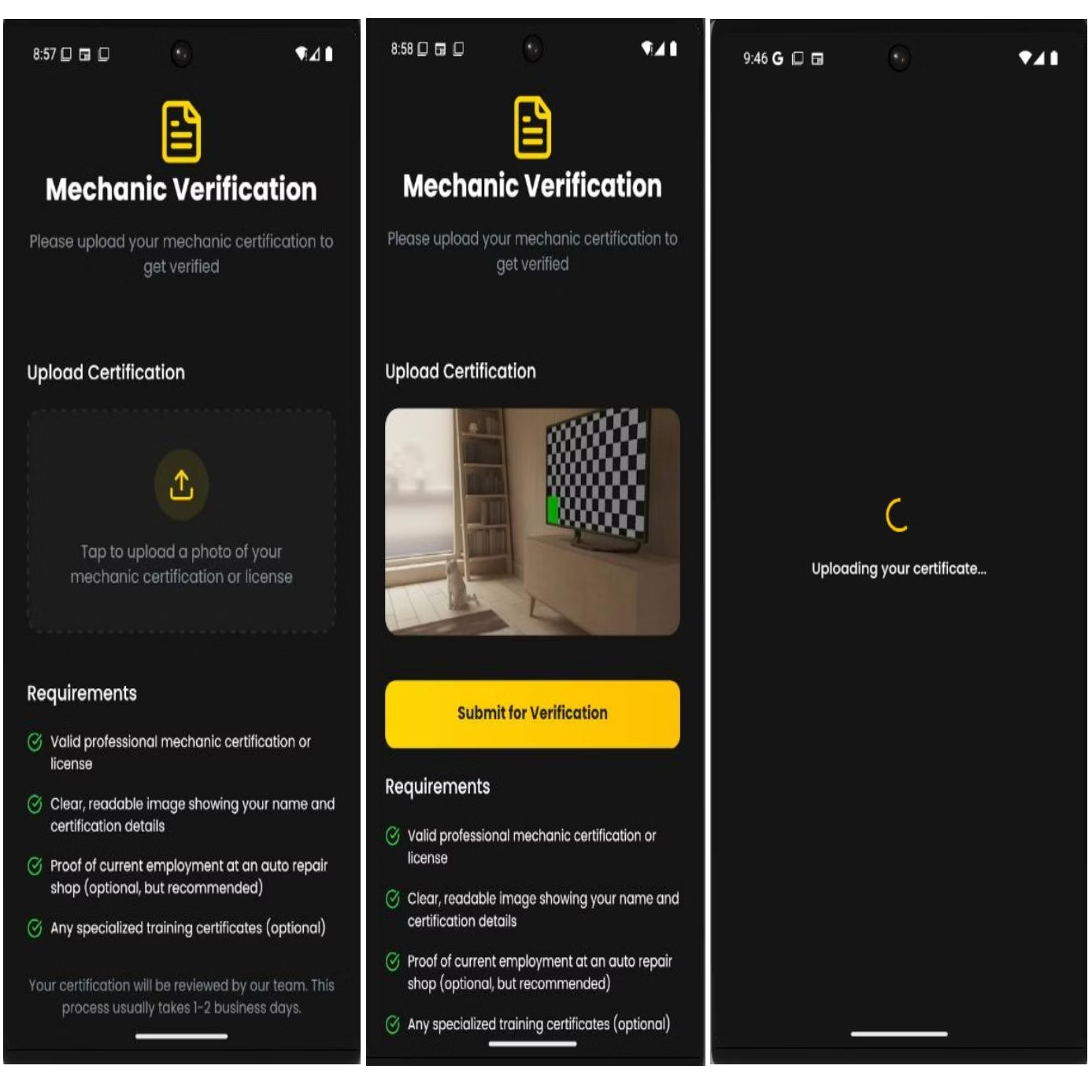
Mechanic Verification and Dashboard
Mechanics must undergo a verification process to ensure qualification. This involves uploading certifications or licenses to validate expertise and protect users. Mandatory requirements include a valid professional license and a clear image of credentials.
Once verified, mechanics access a tailored dashboard to manage their professional details, including business address, phone number, specialization (e.g., "Engine Repair"), and years of experience. This information helps customers locate and choose the right professional, enhancing trust and service matching.
Upload Certification
Submit valid professional license or certification.
Verification
Credentials are reviewed for validation.
Mechanic Dashboard
Access tailored features and manage profile.

Slide 10





Frontend Implementation and Conclusion
The frontend implementation transforms design concepts into an interactive mobile application. Developed using React Native, the app emphasizes usability, performance, responsiveness, and consistency across Android and iOS. Expo Framework streamlines the workflow, simplifying access to native APIs.
React Navigation handles in-app navigation, while Expo Camera & Audio enable real-time data acquisition for diagnostics. TypeScript ensures type safety, and Context API manages global state. This robust technology stack supports a seamless, intelligent car fault diagnostic experience, bridging concept to reality.
React Native
1
Core framework for cross-platform development.
2
Expo Framework
Streamlines development, access to native APIs.
3
React Navigation
Handles fluid in-app navigation.
4
Expo Camera & Audio
Enables real-time data acquisition.
5
TypeScript
Ensures type safety and maintainability.

Slide 11
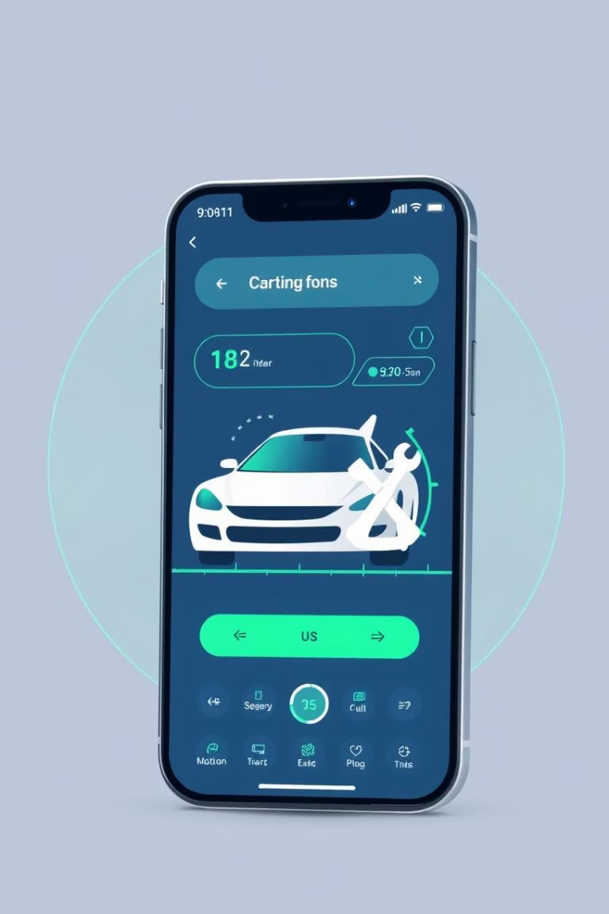
Car First Aid: Conclusion
Car First Aid revolutionizes vehicle diagnostics. It delivers seamless, intelligent solutions for drivers.
Mechanics find a platform for verified service. This connects users to trusted professionals.
Our robust technology ensures a reliable experience. We envision a future of stress-free car care.

